Slide 1

Master of Science in Data Analytcs
Applied Research Project
B9DA113_2223_TMD1S
Topic
Textile Fabric Defect Detection Using Artificial Intelligence Algorithms
Presented By: Saima Saleem
Student ID: 10603707

Slide 2
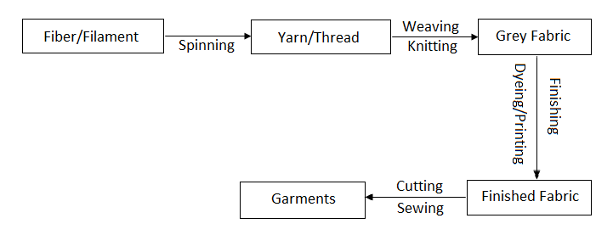
Textile Manufacturing Process
https://1.bp.blogspot.com/-KQByBxGibqo/V948BFOlV6I/AAAAAAAABTA/SF8-vCm9ezIpK6gJ4Ct7jFAgS6ajemFngCLcB/s1600/General%2BProcess%2BSequence%2Bof%2BTextile%2BManufacturing.png

Slide 3
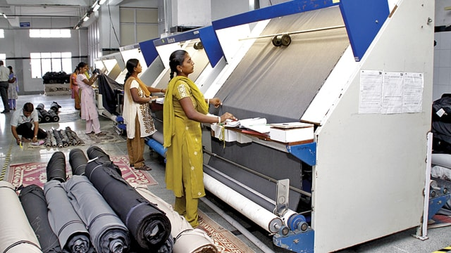
Fabric Inspection Methods
Manual Fabric Inspection
A fabric inspector pulls the fabric over the table, detects the faults and marks the defects
https://apparelresources.com/technology-news/manufacturing-tech/technology-levels-for-fabric-inspection/

Slide 4
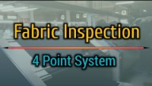
https://youtu.be/4Ais9lAAVEs

Slide 5
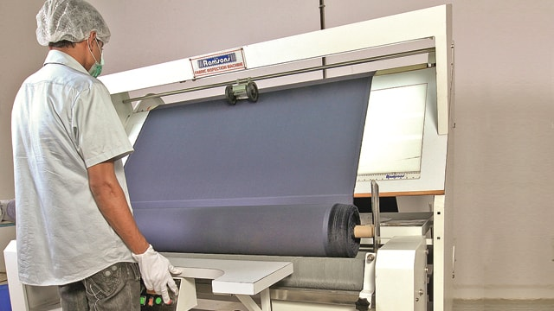
Fabric Inspection Methods
Mechanical or Semi-automatic Fabric Inspection
Widely used method as it is faster but results are dependent on the inspector’s skills and expertise.
Fabric inspection machines are power driven with variable speed control drive.
Fabric runs smoothly and under a meter counter.
RF 101 by Ramsons
MASTER RII by Paramount
https://apparelresources.com/technology-news/manufacturing-tech/technology-levels-for-fabric-inspection/

Slide 6
Fabric Inspection Methods
Software add-ons for Defect Detection
Software FIDAS ( Fabric Inspection Defect Analysis Software)
Defect is entered using touch screen monitor.
Automatic grading based on the number of defects.
Helps in selecting rolls with less defects.
Increased production rate.
Reduced dependency on manpower.
https://apparelresources.com/technology-news/manufacturing-tech/technology-levels-for-fabric-inspection/

Slide 7
Problem Statement In Textile Industry, fabric inspection is a challenging task as the price of end product is based on the quality of the product. Fabric is inspected manually

Slide 8
Conventional Method Training of individuals Major defects can be detected, minor remain undetected Laborious task-lots of human effort required to keep focus on production Time Consuming

Slide 9
Scope Although a lot of research has been done but those methods and mechanisms are rarely used in the industry. Either the available methods are expensive or rarely found in commercial market.

Slide 10
Requirement
A need to automate the process
Using artificial intelligence and machine learning algorithms

Slide 11
Requirements model should have a high detection accuracy Model should be fully trained for all types of fabrics A high detection speed for real time implementation

Slide 12
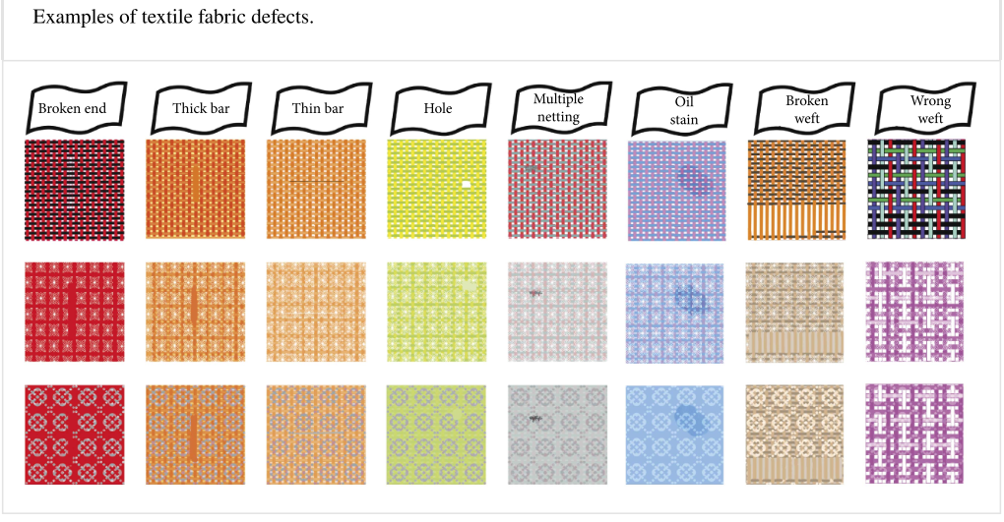
https://www.hindawi.com/journals/mpe/2020/8189403/fig2/

Slide 13
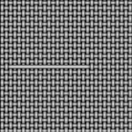
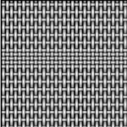
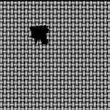
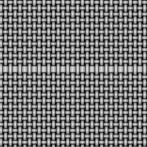
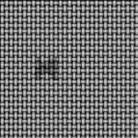
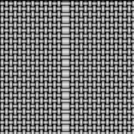
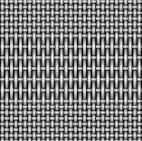
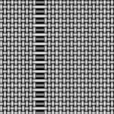
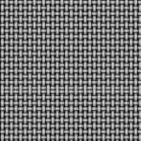
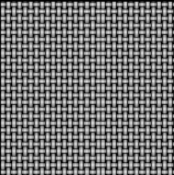
Hole
Weft yarn defect
Float
Excessive weft density
Oil Stain
Warp yarn defect
Insufficient weft density
Broken end
https://www.hindawi.com/journals/mpe/2020/8189403/fig2/
Double Pick
Double End

Slide 14
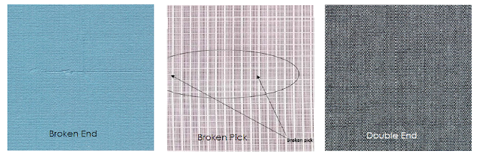
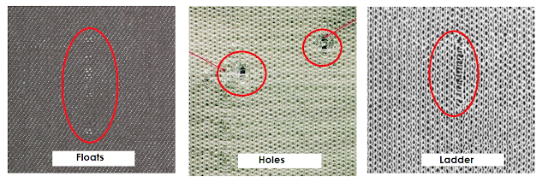
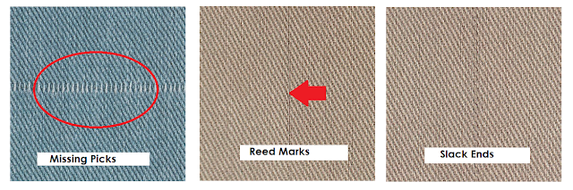
https://www.onlineclothingstudy.com/2019/02/classification-of-fabric-defects.html#:~:text=A%20fabric%20defect%20corresponds%20to%20a%20flaw%20on,are%20caused%20by%20faulty%20yarns%20or%20machine%20spoils.

Slide 15
Data is the heart of AI!
Path to better quality comes from past data!
https://medium.com/@keerthika.v.24/defect-detection-using-artificial-intelligence-in-software-testing-learning-from-other-industries-83a83ef8874b

Slide 16
Benchmarking
Motorola’s “Instrumental Inc”
Aggregates image data into cloud database, analysis by algorithms to identify defects
Hong Kong Polytechnic University’s “WiseEye”
Thousands of yards of fabric data is fed into system to detect 40 common defects using big data and deep learning technologies
https://medium.com/@keerthika.v.24/defect-detection-using-artificial-intelligence-in-software-testing-learning-from-other-industries-83a83ef8874b

Slide 17
Fabric Defect Detection Methods
ALGORITHMS
Traditional Algorithms
Learning Based Algorithms
TEAM A
TEAM B
Conventional
Deep Learning
One Stage Detector
Single shot multibox detector (SSD) using CNN and DCNN
Two Stage Detector
modified Faster R-CNN model using region proposal network (RPN) with the CNN
Dictionary Learning-Based Algorithms.
Statistical
Structural
Spectral
Model Based
EMPLOYEE A
EMPLOYEE B
EMPLOYEE C
EMPLOYEE D
EMPLOYEE E
EMPLOYEE F
Key result 1
Key result 2
Key result 1
Key result 2
Key result 1
Key result 2
Key result 1
Key result 2
Key result 1
Key result 2
Key result 1
Key result 2
https://www.hindawi.com/journals/scn/2021/9948808/

Slide 18
WHY DEEP LEARNING
Learning Based Methods Based on CNNs
Use convolutions to extract features automatically through learning
Reduces steps of manual feature extraction
But require much data
Problem with the collection of large data
As online detection requires high real time performance; need to improve the detection speed
Traditional Methods Based on Image Processing
Deal with single image
Use hand-designed features to detect defects such as filters, texture, color features.
Need to set parameters for different textures and defects.
EMPLOYEE A
EMPLOYEE B
EMPLOYEE C
EMPLOYEE D
EMPLOYEE E
EMPLOYEE F
Key result 1
Key result 2
Key result 1
Key result 2
Key result 1
Key result 2
Key result 1
Key result 2
Key result 1
Key result 2
Key result 1
Key result 2

Slide 19
DATASET
The dataset consisted of the images from the following:
Fabric Defect Dataset from Kaggle (Ranathunga, 2020)
Fabric Stain Dataset from Kaggle (Pathirana, 2020).
Aitex fabric image database (Silvestre-Blanes et al., 2019)
Dataset from the author of the literature review paper (Peng et. al. 2020): only the non-defect images from the dataset of the author of the literature review are taken
EMPLOYEE A
EMPLOYEE B
EMPLOYEE C
EMPLOYEE D
EMPLOYEE E
EMPLOYEE F
Key result 1
Key result 2
Key result 1
Key result 2
Key result 1
Key result 2
Key result 1
Key result 2
Key result 1
Key result 2
Key result 1
Key result 2

Slide 20
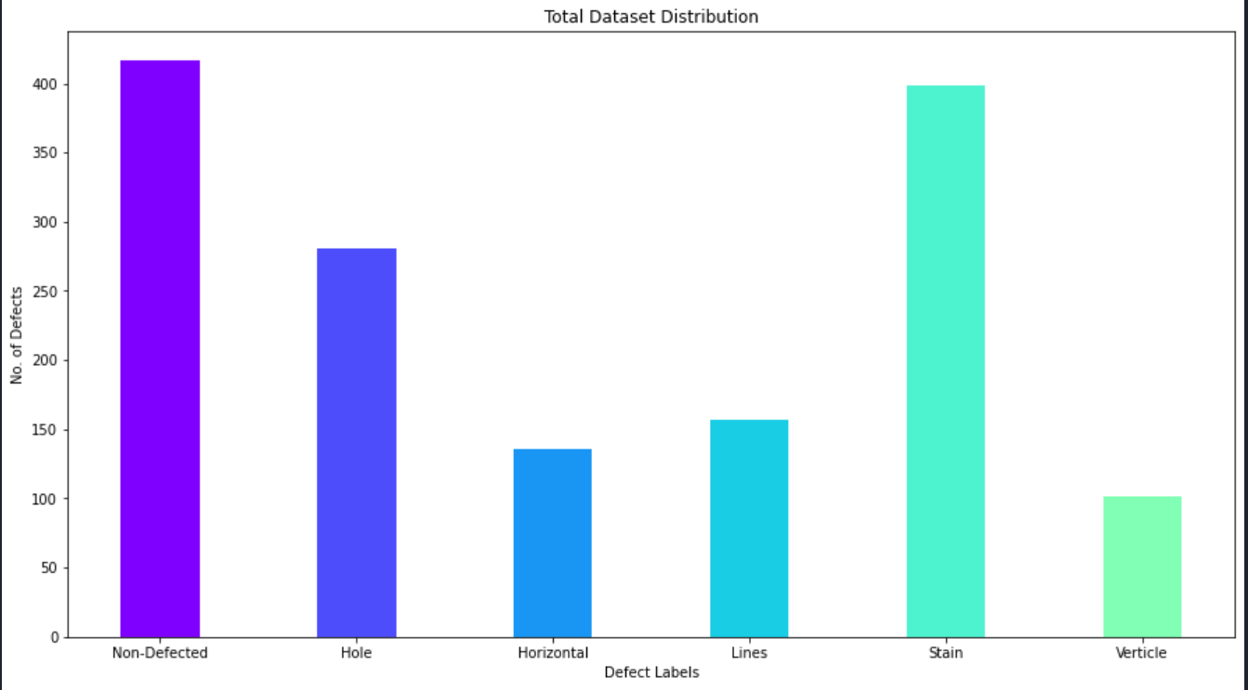
DATASET
Defect Free images 417
Defected Hole images 281
Defected Horizontal images 136
Defected Lines images 157
Defected Stain images 398
Defected Verticle images 101
EMPLOYEE C
Total number of defected images = 1073
Total number of non-defected images = 417
EMPLOYEE A
EMPLOYEE B
EMPLOYEE D
EMPLOYEE E
EMPLOYEE F
Key result 1
Key result 2
Key result 1
Key result 2
Key result 1
Key result 2
Key result 1
Key result 2
Key result 1
Key result 2
Key result 1
Key result 2

Slide 21
MODEL
CNN Model 5 convolutional Layers:
Filters 16 stride 7x7
Batch Normalization
RELU – Activation Function- replaces all negative values by zeros
Max Pooling to reduce image size/ parameters-output is same number of feature maps but much small.
Dropout Layer- To avoid overfitting
Filters 32 kernel 5x5
Filters 64 kernel 3x3
Filters 64 kernel 3x3
Filters 128 kernel 3x3
Flatten Layer – From matrix to Vector
Fully connected layer – Dense layer with 64 nodes
Softmax – Activation function

Slide 22
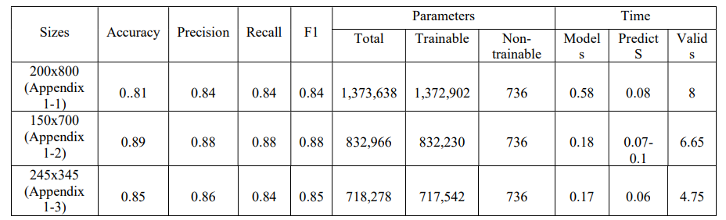
Experimentation
Performance of the model experimented with the three sizes of the images in dataset
Test size= 0.2 epoch = 100 batch size = 16
https://drive.google.com/drive/folders/16nup58ZMk8kJ9g3fOxfIx6TfoLdPoEbR?usp=sharin g

Slide 23
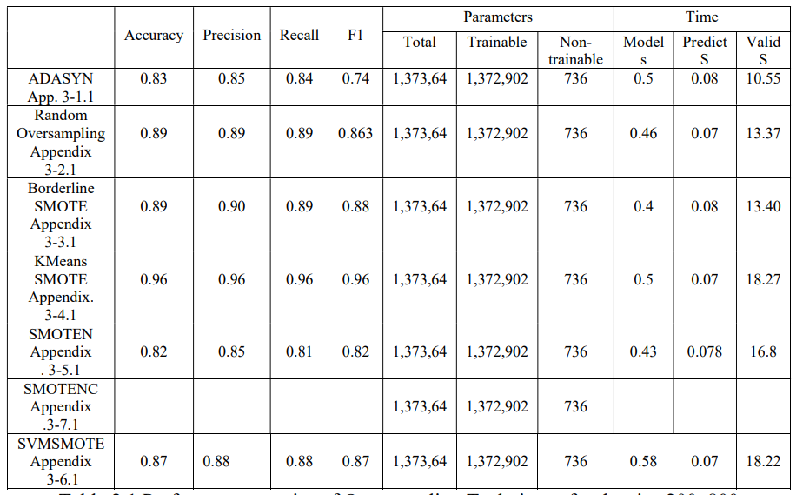
Experimentation
Oversampling 200x800
https://drive.google.com/drive/folders/1b3bP8USc2V9WepNLWCHnngxdBqD3W0Fb?usp= share_link

Slide 24
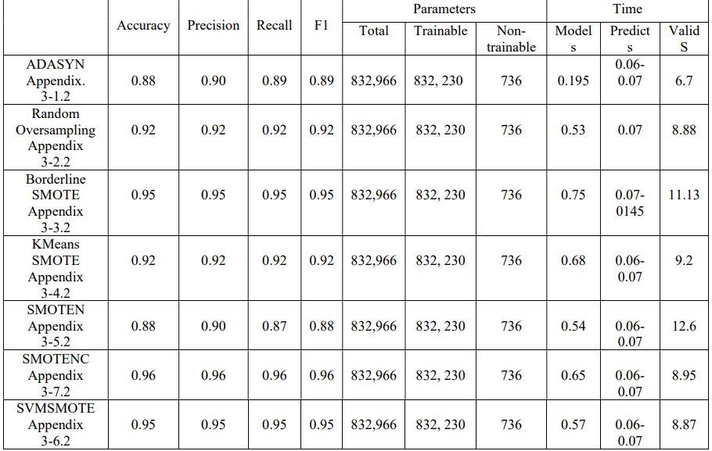
Experimentation
Experimentation
Oversampling 150x700
https://drive.google.com/drive/folders/1b3bP8USc2V9WepNLWCHnngxdBqD3W0Fb?usp= share_link

Slide 25
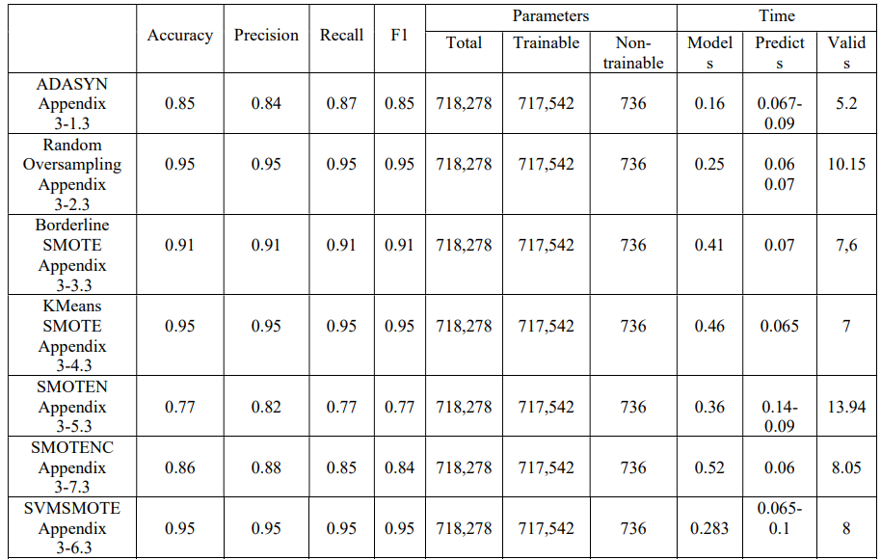
Experimentation
Oversampling 245x345
https://drive.google.com/drive/folders/1b3bP8USc2V9WepNLWCHnngxdBqD3W0Fb?usp= share_link

Slide 26
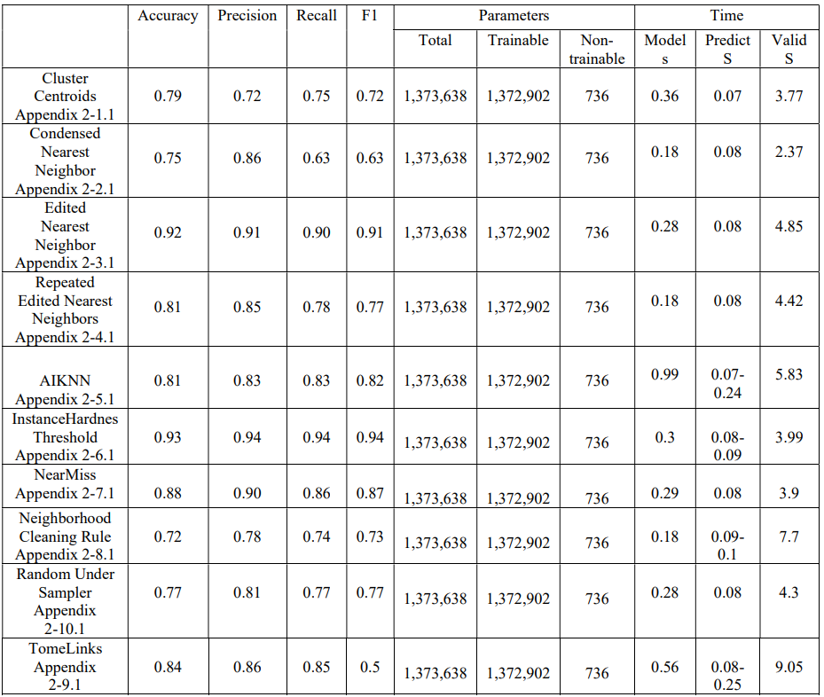
Experimentation
Undersampling 200x800
https://drive.google.com/drive/folders/1F9SBxMXpmYYK_UjqifzkFt9DHibUypWX?usp=sharing

Slide 27
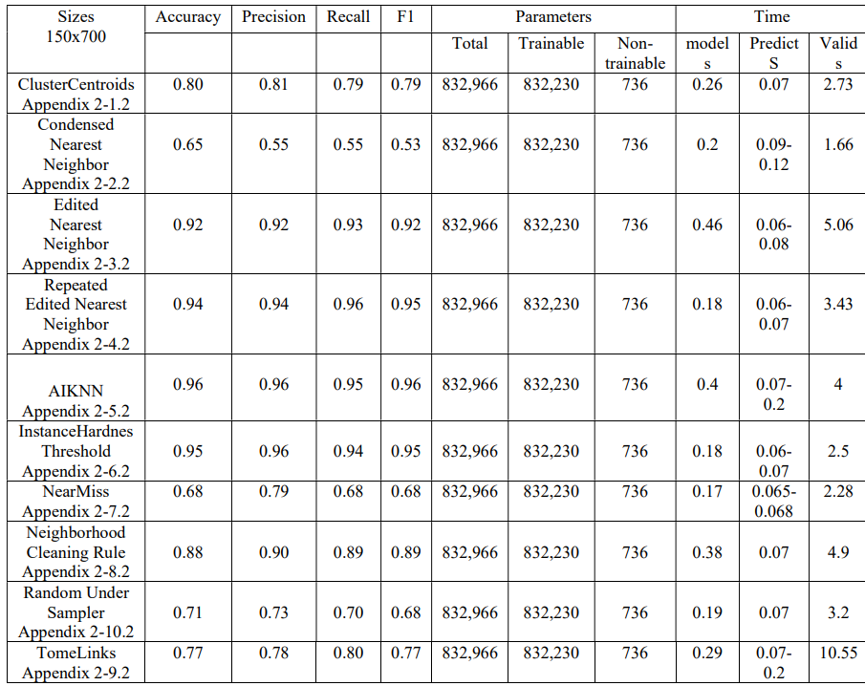
Experimentation
Oversampling 150x700
https://drive.google.com/drive/folders/1F9SBxMXpmYYK_UjqifzkFt9DHibUypWX?usp=sharing

Slide 28
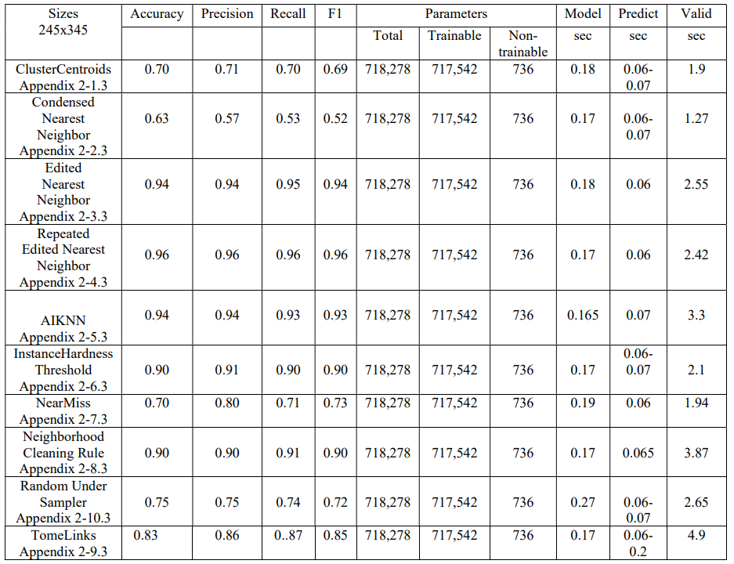
Experimentation
Undersampling 245x345
https://drive.google.com/drive/folders/1F9SBxMXpmYYK_UjqifzkFt9DHibUypWX?usp=sharing

Slide 29
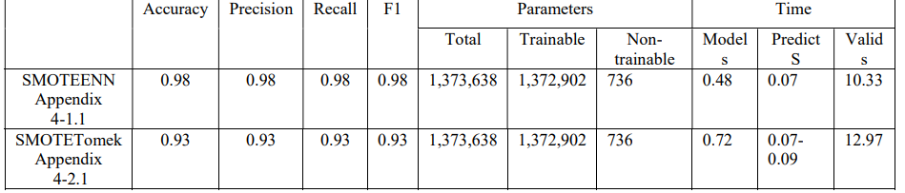
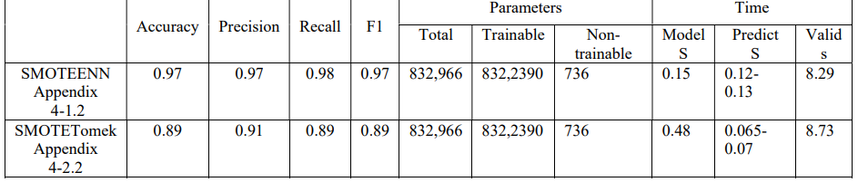
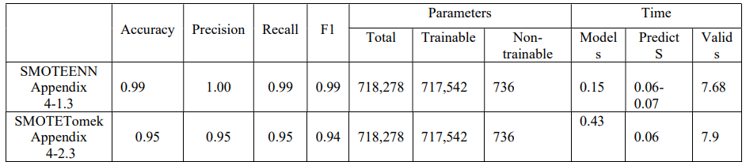
Experimentation
Oversampling + Undersampling
Size 200x800
Size 150x700
Size 245x345
https://drive.google.com/drive/folders/1oi6M0aC9bbq6w0lE7CXiOPh6nIj_BiV?usp=sharing

Slide 30
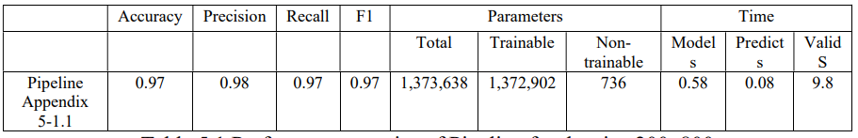
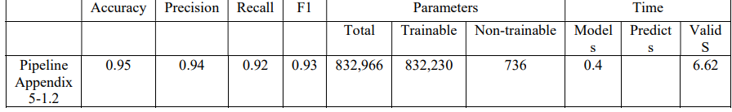
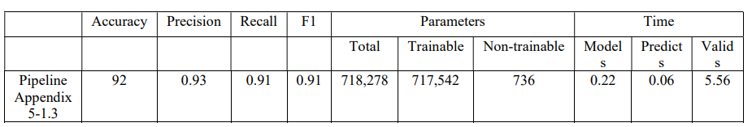
Experimentation
Ensemble
Size 200x800
Size 150x700
Size 245x345
https://drive.google.com/drive/folders/1w_Cg8W23IHCdvc81IXBU8tkHJYY11S7X?usp=sharing

Slide 31
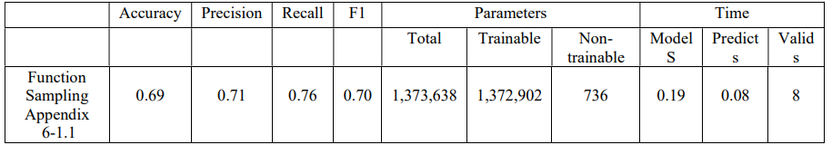
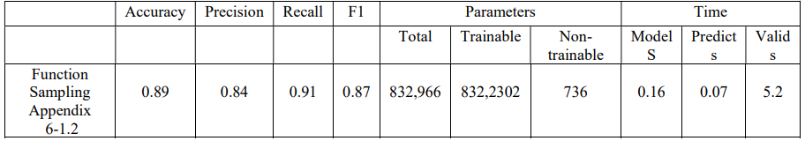
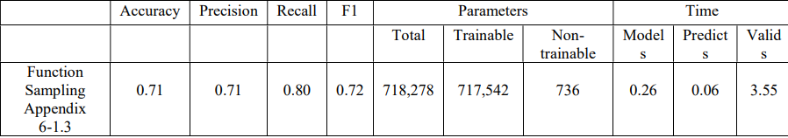
Experimentation
Miscellaneous
Size 200x800
Size 150x700
Size 245x345
https://drive.google.com/drive/folders/110f6tfFU_8UY5qtJRkePAtPXmVPwmklW?usp=sharing

Slide 32
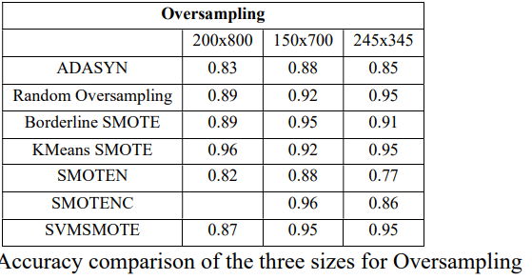
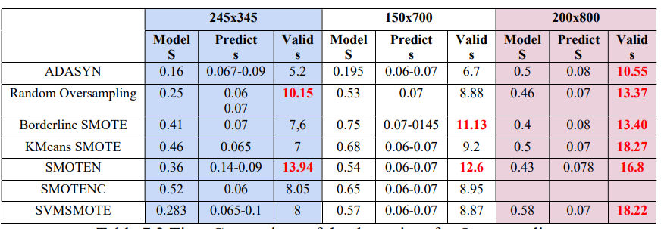
Discussion Oversampling

Slide 33
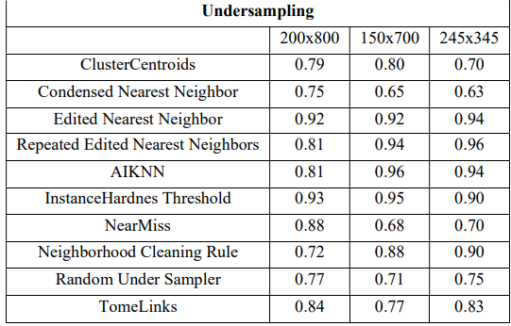
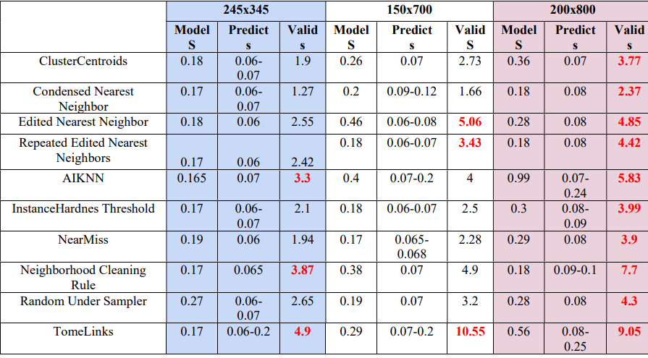
Discussion Undersampling
Accuracy comparison of the three sizes for undersampling

Slide 34
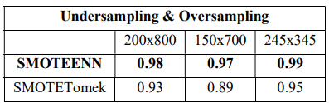
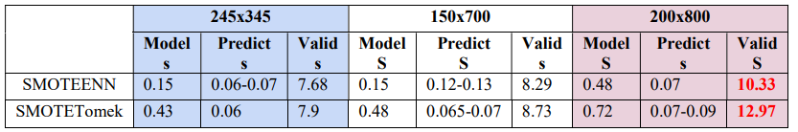
Discussion Oversampling + Undersampling
Accuracy comparison of the three sizes for Oversampling +undersampling

Slide 35
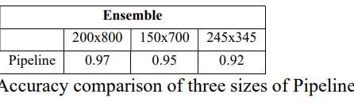
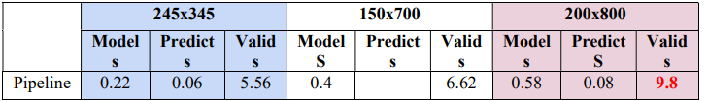
Discussion Ensemble

Slide 36
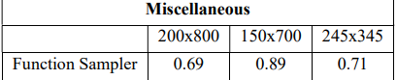
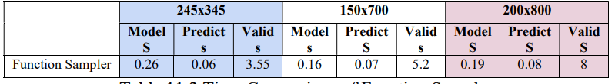
Discussion Miscellaneous
Accuracy of Function Sampler

Slide 37
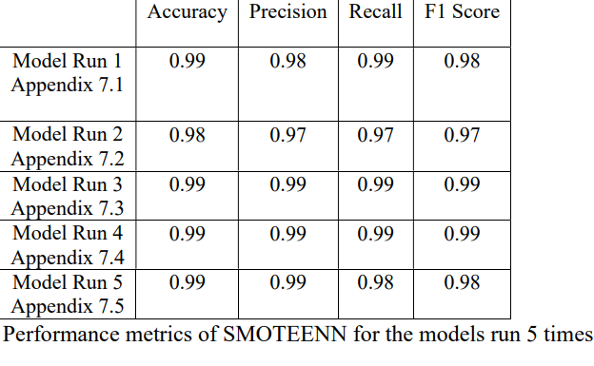
Results Verification
https://drive.google.com/drive/folders/1LzaRMymVdkwViJFK00aPHCRtVDGWar1?usp=sharing

Slide 38
Results Verification
From Literature Review
CNN has a significant impact on the accuracy of image resolution.
Image sizes have a significant effect on the accuracy of any model. Any change in the sizes may degrade or enhance the performance of the model.
Accuracy increases on increasing the image sizes but decreases on increasing beyond a certain level because of the decrease in the level of receptive field.
As image size increases, the ability to learn medium and high-level features is affected.
To achieve higher accuracy, optimal image size lies between default size and 512.
Resizing images affect low level features due to information loss. Accuracy is affected as inter-class similarities are highly dependent on low-level features
(Luke, Joseph and Balaji, 2019)

Slide 39
Results Verification
From Literature Review
Image resolution has a major influence on the performance of the model
Performance of CNN best with a large image size of 512x512 as compared to 32x32.
(Thambawita, et al., 2021)

Slide 40
Results Verification
From Literature Review
Lesser the number of parameters, the higher is the model performance
High level of resolution reduction may result useful information loss.
CNN performed better between resolutions of 256x256 and 448x448 image sizes.
Increasing image resolution has a trade-off with the maximum possible batch size.
(Sabottke and Spieler, 2020)

Slide 41
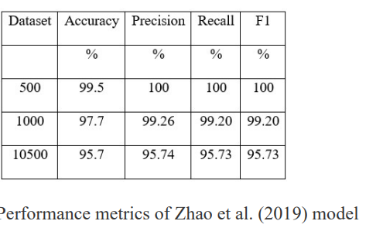
Results Comparison
From Literature Review
The model was based on visual long- short term memory

Slide 42
Conclusion
It was also found out that CNN model performed best with SMOTEENN sampling technique.
The developed CNN model showed best performance with SMOTEENN sampling technique.
From among the three image sizes 200x800, 150x700 and 245x345, the best performance was with 245x345.
This model can be deployed in the industry as the model took only 0.15 sec for validation and 0.06 sec for prediction.

Slide 43
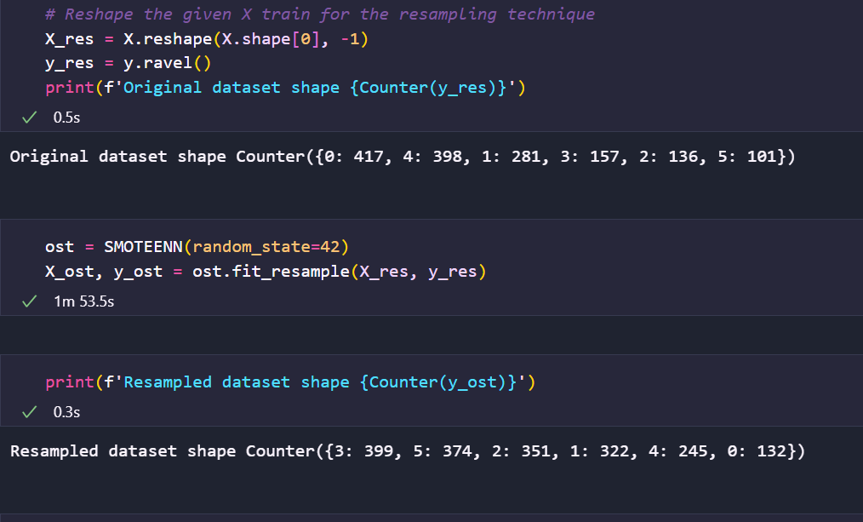
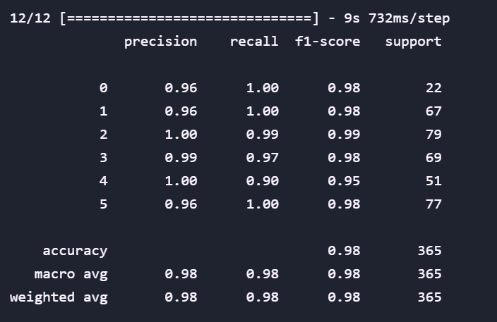
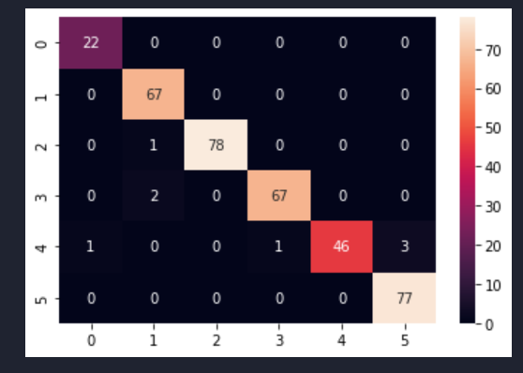

SMOTEENN size 200x800

Slide 44




SMOTEENN size 150 x700

Slide 45




SMOTEENN size 245x345

Slide 46




SMOTEENN Size 200x800
PCA Before and After Sampling

Slide 47



SMOTEENN Size 150 x700
PCA Before and After Sampling

Slide 48



SMOTEENN Size 245 x345
PCA Before and After Sampling

Slide 49

Conclusion
Automated Fabric Defect Detection

Slide 50
Future Research
More research is required by increasing the number of images and types of defects for multiclassification.
More research is required to deploy this model in the textile industry with the installation of infrared cameras and defect labelling machine to automate the whole system of quality inspection.

Slide 51
Future is in our hands!

Slide 52

My Idea
THANK YOU

Slide 53
References
Luke, J. J., Joseph, R. and Balaji, M. (209),’Impact of image size on accuracy and generalization of convolutional neural networks’, International Jouranl of Research and Analytical Reviews Ijrar, 6(1), pp.70-80, Available at: https://www.researchgate.net/publication/332241609.
Sabottke, C., E. and Spieler, B. M. (2019) ‘The Effect of Image Resolution on Deep Learning in Radiography’, Radiology: Artificial Intelligence, 2(1), pp.1-7, Available at: https://doi.org/10.1148/ryai.2019190015
Thambawita, V., Strumke, I., Hicks, S. A., Halvorsen, P., Parasa, S. and Riegler, M. A. (2021), ‘Impact of Image Resolution on Deep Learning Performance in Endoscopy Image Classification: An Experimental Study Using a Large Dataset of Endoscopic Images’ , National Library of Medicine,11(12):2183, doi: 10.3390/diagnostics11122183
Zhao, Y., Hao, K., He, H., Tang, X. and Wei, B. (2019) ‘A visual long-short-term memory based integrated CNN model for fabric defect image classification’ Neurocomputing, 380, pp. 259–270. doi: 10.1016/j.neucom.2019.10.067.

